Slide 1
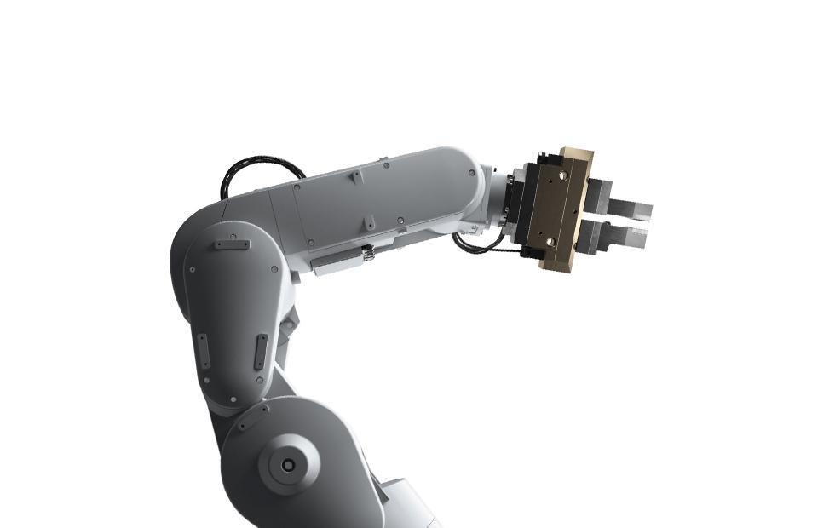
Green Swan - Apple
iPhone Zero
Electronic Waste (iZEW)
Irina Spector, Sami Ki, Whitney Smith-Burghes

Slide 2
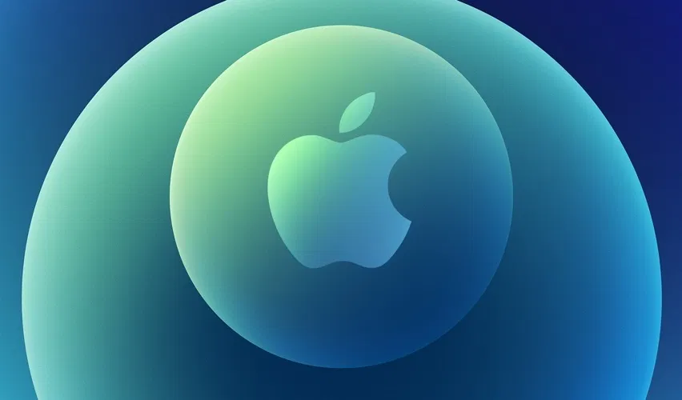
Agenda
Apple’s Green Swan Transformation
Apple’s Company
& Industry Background
India as Geography
Selection
Green Swan Initiative: Introducing iZEW
iZEW’s Multi-Pronged Approach
Funding & Roadmap
Recommendations & Conclusion

Slide 3
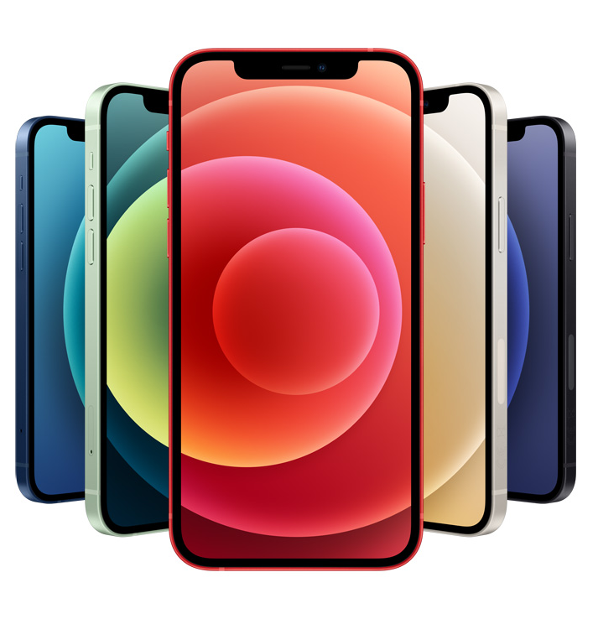
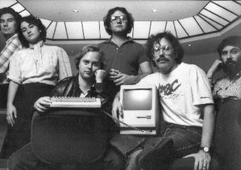
A Brief History
Cupertino, CA
11%
2T USD
TEXT
1976
August 2020

Slide 4
Circular at Apple
CIRCULAR INPUTS
RESOURCE RECOVERY
PRODUCT USE EXTENSION
Recycled rare earth minerals
Renewable energy
Product buy-back
Electronic recycling
Product refurbishment

Slide 5
ICT Industry
116%
70%
Projected Industry Growth by 2030
To $1.3 Trillion from current size of $.6 Trillion
50M tons
Of hazardous materials in landfills is e-waste.
Of e-waste generated annually
Apple operates within a growing industry, in which e-waste is becoming a significant global problem.
Valuable raw materials in devices that could be recovered:
Aluminum
Copper
Gold
Silver
Platinum
Rare Earth Minerals
20%
28%
$20-50B
Growth in e-waste projected by 2025, to 64m tons
Of all e-waste is formally recycled
Estimated Opportunity of circular activities

Slide 6
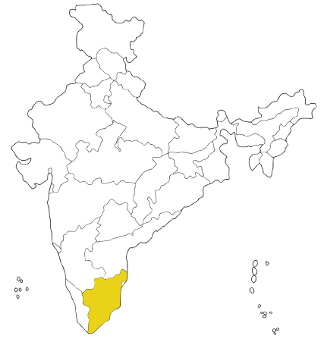
Geography Selection
India offers great potential for Apple’s iZEW initiative
India
Population - 1.38 billion
Ranks in the lowest quartile by GNI/capita
Produced E-waste in 2019 - 3.2 metric tons
Apple market share - 3.35%
Enforcement of e-waste laws lags behind
Manual E-waste collection done by informal waste collectors
Tamil Nadu
The 7th most populous state in India
2nd largest e-waste generating state in India
Chennai is the third top e-waste generating city in India
Disadvantaged classes represent a majority of the population
Foxconn has assembly plant for iPhones near Chennai
★ Chennai
Tamil Nadu

Slide 7
iPhone Zero E-waste (iZEW)
Introducing
Apple is on a mission to eliminate all e-waste.
RFID embedded traceability technology supports all of iZEW’s key activities through three main approaches:
Circular Design & Modularity
Repair & recycling
iPhone as a Service

Slide 8
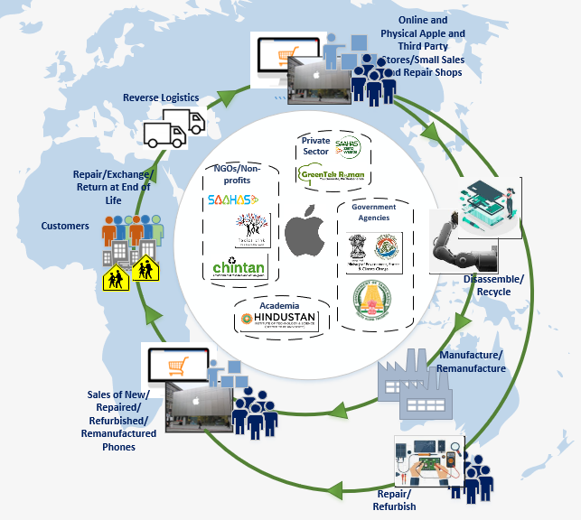
Approach 1 -
Circular Inputs
Create circular ecosystem for iPhone
Build facilities to refurbish, disassemble, and re-manufacture iPhones in India.
Create e-waste collection and recycling programs
R&D on innovative disassembly and recycling technologies
Partner with government agencies and NGOs on:
Waste recycling policies
Safe jobs with fair pay
Working conditions for informal waste collectors

Slide 9
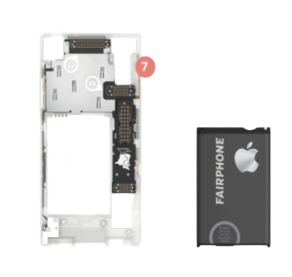
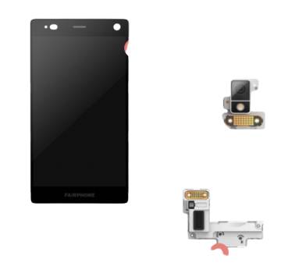
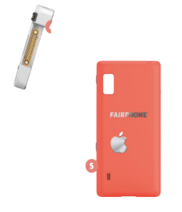
Approach 1-
Modularity
Launch the “iPhone Fair” model in partnership with Fairphone
Facilitates product life extension
Modularity will make phone repairs and upgrades easier and more accessible
R&D on easy parts removal and disassembly in all future models

Slide 10
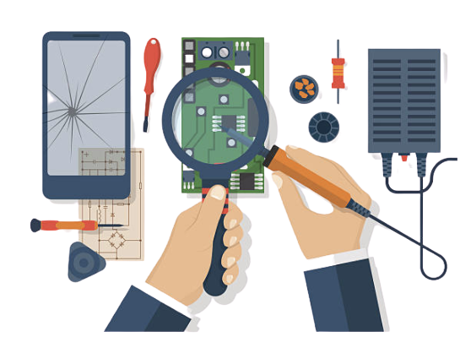
Approach 2-
Repair & Recycling
Ecosystem of small shops to sell new as well as refurbished and remanufactured phones, make repairs, and take back used phones
Specialized programs for small entrepreneurs
Technology and quality control training programs
Incentive programs for customers to bring iPhones to authorised dealers for repairs, upgrades, exchanges and end-of-life disposal.

Slide 11
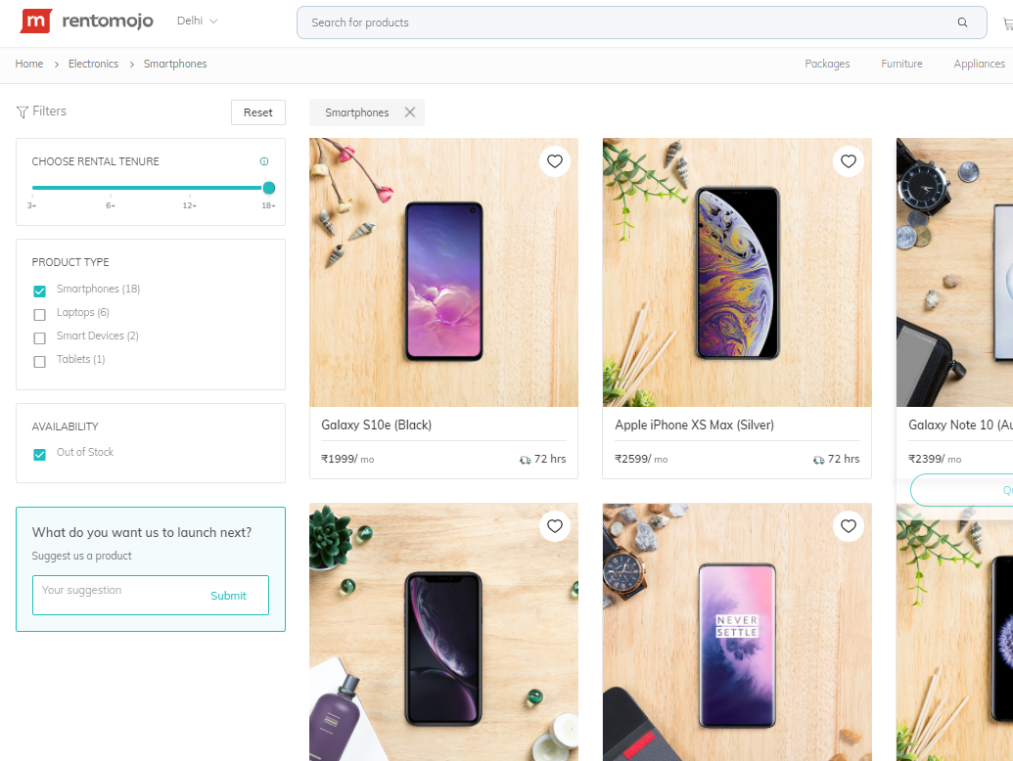
Approach 3-
iPhone as a Service
Grow market share in India through new revenue streams.
40%
Rental Model poses a lucrative business opportunity
Of Indians would like to upgrade their phones within a year
2 of 3
People in India are Millennials
iPhones can be rented on Apple’s online store, brick and mortar store (opening 2021), partner repair shops, and Rentomojo.

Slide 12
Funding for iZEW
Apple has deep pockets to launch and scale iZEW’s activities.
Market Capitalization, August 2020
$2 T
$13 B
Q3 2020 Operating Income
Total amount of 3 Green Bonds since 2016
$4.6 B
New 2020 Green Bond issuance for iZEW
$1.9 B

Slide 13
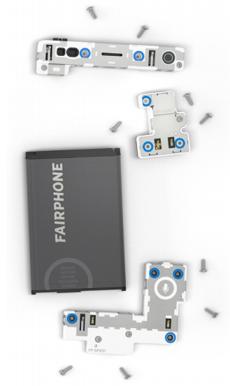
iZEW Roadmap
Within First 6 Months
Year 2
Roll out education and training for waste collectors, repair & rental shop staff.
Year 4
Beta test RFID traceable tech on existing iPhone parts.
Launch modular iPhone with Fairphone.
Year 3
Year 5
Within First 12 Months
Begin receiving parts back, send for recycling, and re-introduce into the supply chain.
Fully Circular iPhone
Establish partnerships.
Design and plan infrastructure.

Slide 14
Apple is leading the circular revolution
ALL in on circular inputs
Rewrite the recovery story
Tech authenticated circularity
R&D investment to spur innovation and achieve 100% circular inputs.
Engagement across value chain using PaaS, take back/repair and modularity to ensure 100% resource recovery.
Leverage technology to create traceability along a truly closed loop.

Slide 15
The future of Apple is ZERO impact
0
Virgin resources
100%
100%
Regenerative
100%
Equitable

Slide 16
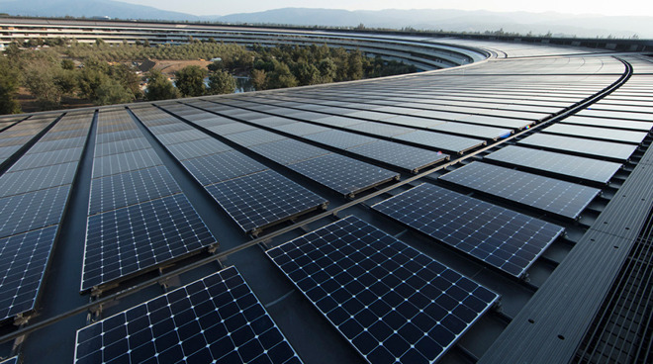
THANK YOU!
Q&A

